Slide 1

CSUN Dashboard
Team Leader: Christian Jarmon
Team: Michael Balian, Nima Shafie, David Huezo

Slide 2
Agenda
The Situation
Solution Definition
The Solution
Software Overview/Topology
Software Requirements
Software Testing
App Demo
Regrets/Lessons Learned
Q/A

Slide 3
The Situation
There exists too much information, in multiple locations
csun.edu (Faculty and Catalog information)
cmsweb.csun.edu (Registration portal)
CSUN Web Services API
Some information simply hard to come by
Most notably, faculty information
More on this later…
There exists portions of information that conflict
Catalog information (in Portal vs csun.edu) not consistent
Section information (i.e. enrollment count) differs in CSUN API and in the Registration Portal

Slide 4
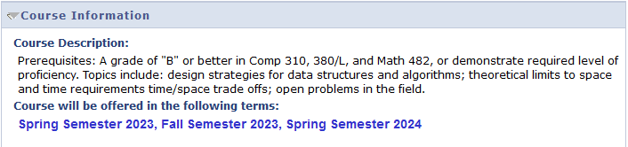
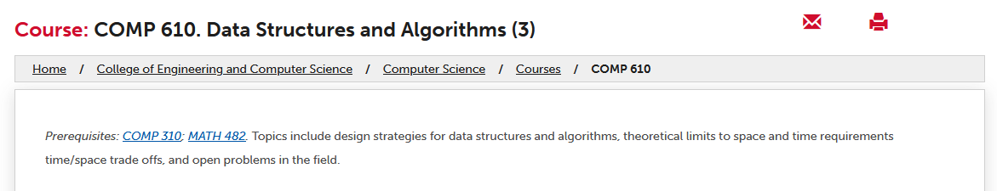
The Situation - Example
For course COMP 610 - Data Structures and Algorithms
Registration Portal - Details Section
catalog.csun.edu

Slide 5
Solution Definition
Gather and centralize all the information of catalogs, professors, majors, and school rules/guidelines.
Establish a philosophy for what information is most accurate

Slide 6
The Solution
Crawl through each possible source of information
Pipe it through a verification process
Any conflicting information is overridden by what is deemed most accurate
Any user facing material or “Point-of-Sale” is most accurate
Registration Portal
csun.edu
CSUN API
Reasoning: Any institution/entity prioritizes keeping information that the stakeholder (students) sees as accurate as possible

Slide 7
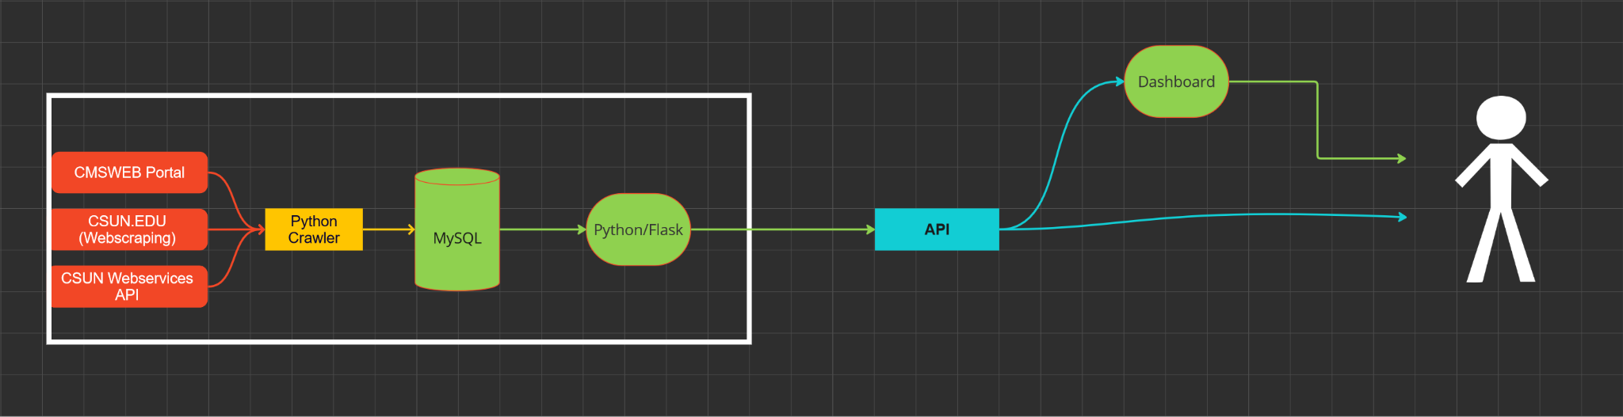
Software Overview/Topology
Development Stack
UI/UX: ReactJS
Server: Flask (Python)
Database: MySQL
Data Crawler: Python
Web Scraping: Selenium
Scheduled using Python’s `schedule`
Automated Testing: Cypress
Deployment Stack
Operating System: Ubuntu Server
Devops: Github Actions
Hosting: Nginx & Digital Ocean

Slide 8
The Crawler - Registration Portal
Recorded sections offered for each class in each subject
Class #
Online Type
Enrollment Count/Cap
Waitlist Count/Cap
Location
Days
Time
Instructor
For each course, records the course description from details section
Only happened once during data aggregation, not on schedule
Used Selenium Webdriver in Python to web scrape *sections* on a schedule
On our Ubuntu Server machine, created a service that is the python crawler
The crawler uses the “schedule” library in Python that runs webscraper for the class schedule every night at midnight
The schedule was changed to weekly after the drop date as things don't change much afterwards

Slide 9
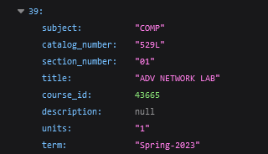

The Crawler - csun.edu/CSUN API
Cross referenced between the two for catalogs university-wide
Specifically needed csun.edu for…
Accurate titles
Course description
Prerequisites
During the initial Data Aggregation phase, the catalog was gathered from the CSUN API.
In said API, some titles were short handed
API also used to source information about Faculty from each department
Was easier and less computationally expensive to do with simple HTTP GET requests
Web Scraping required a traversal of 3 pages
For each department
For each professor
The “Faculty Application” Link

Slide 10
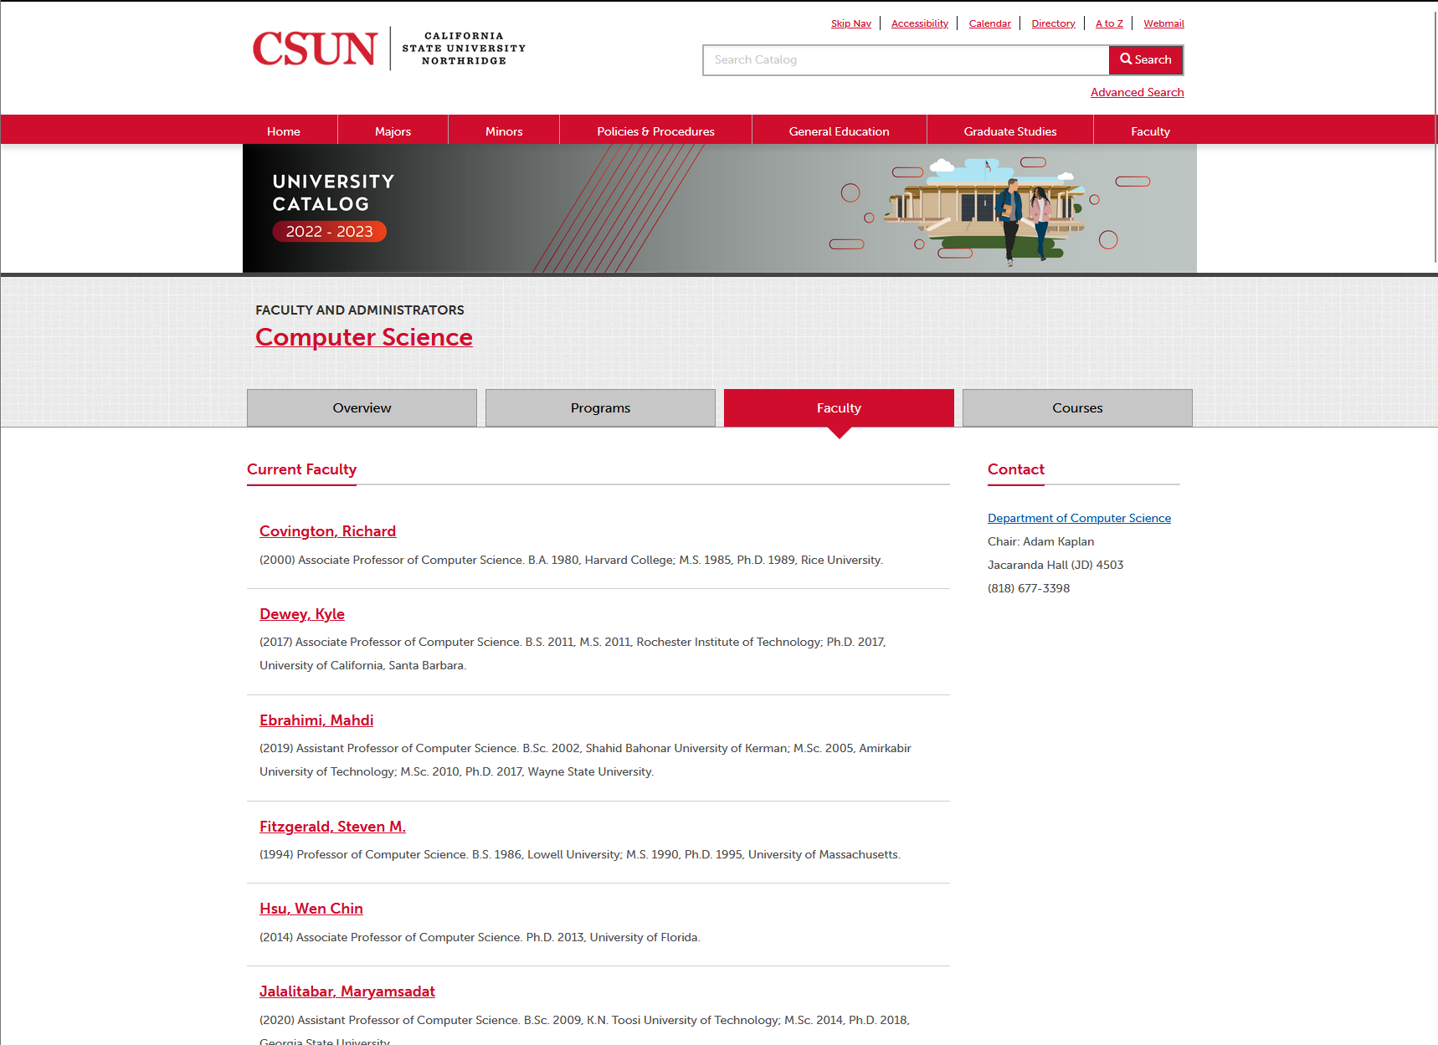
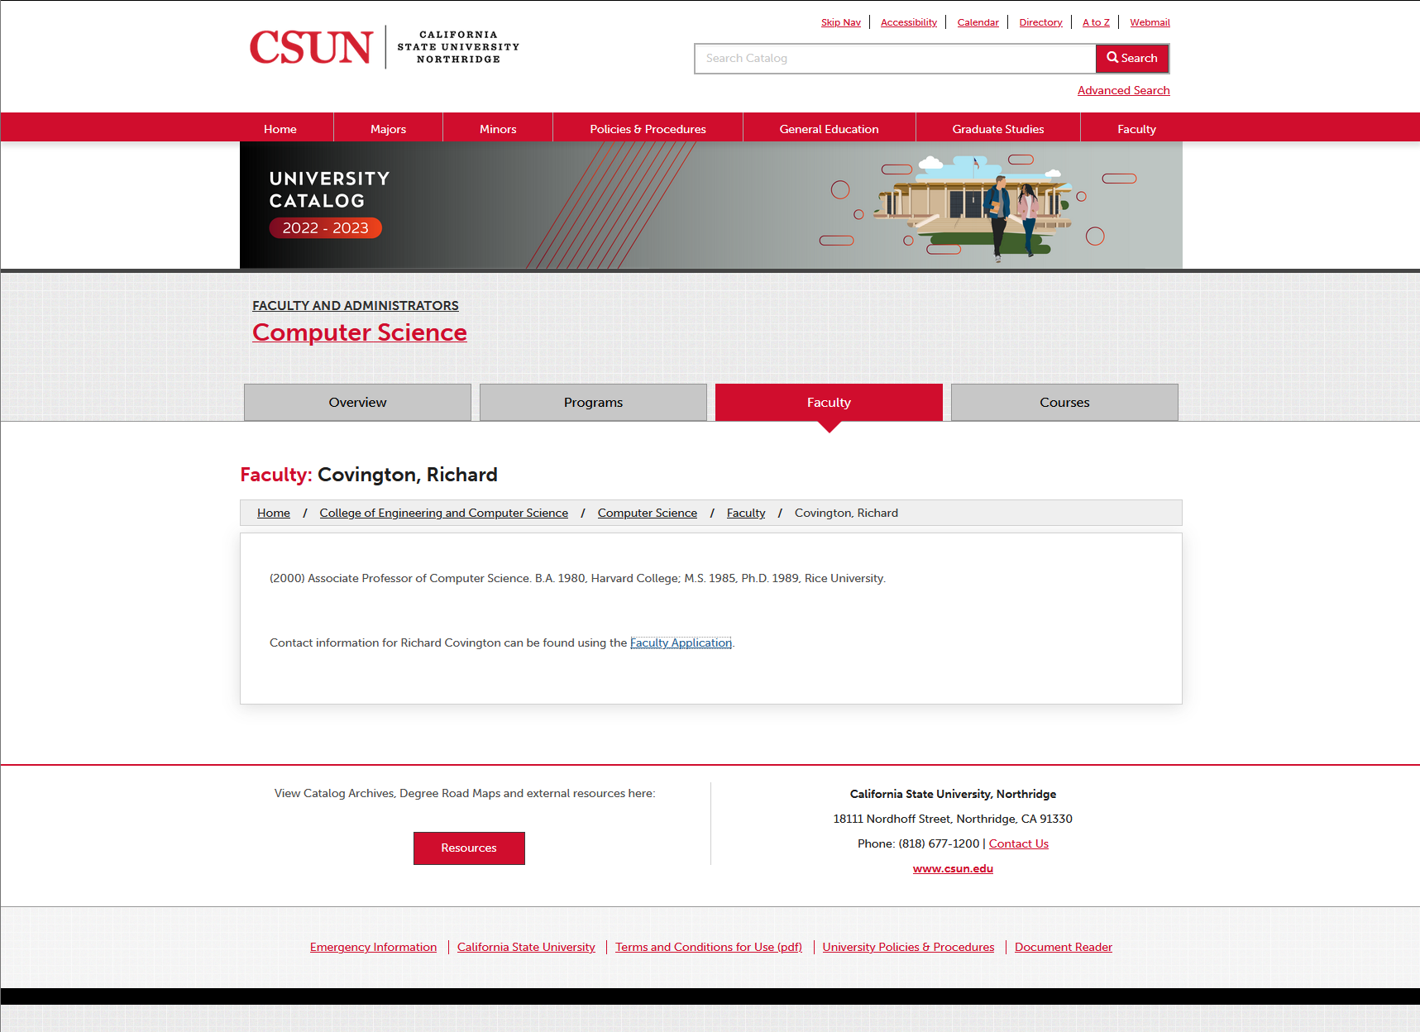
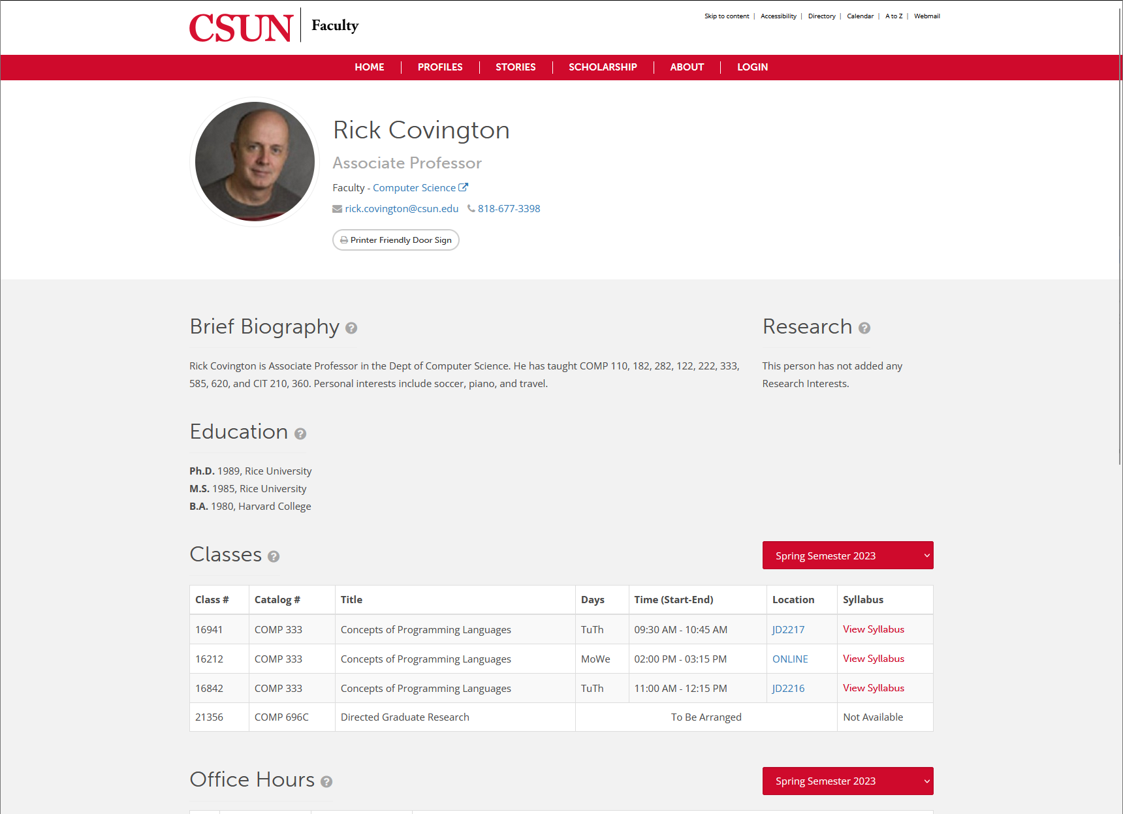
=>
=>
https://catalog.csun.edu/academics/comp/faculty/
https://catalog.csun.edu/academics/comp/faculty/covington-richard/
https://academics.csun.edu/faculty/rick.covington

Slide 11
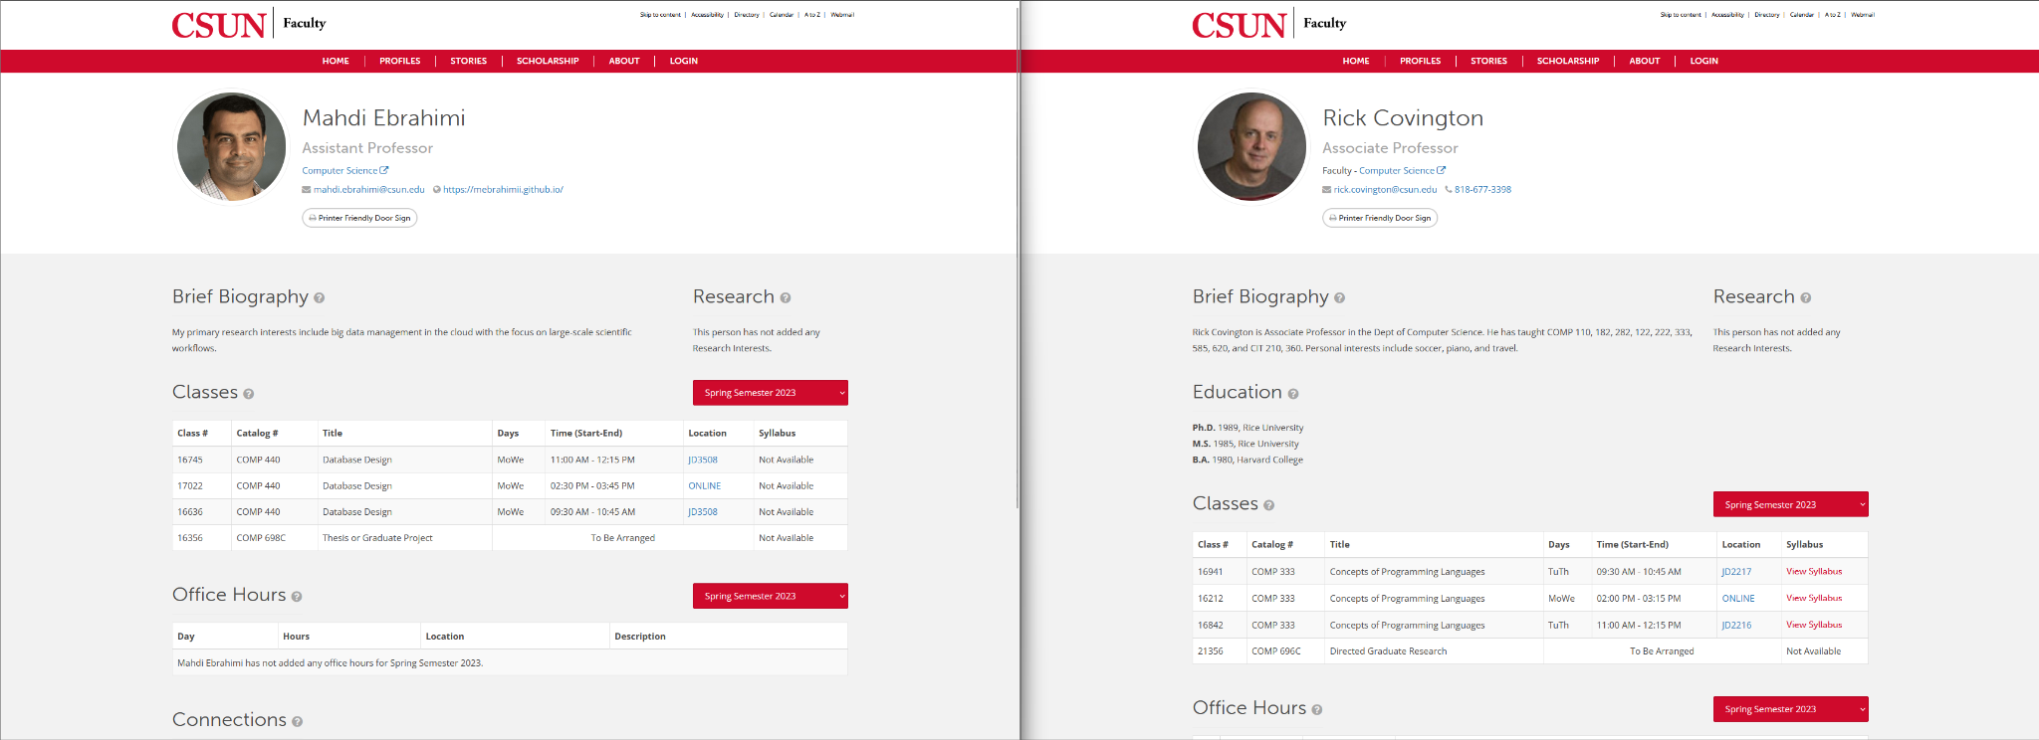
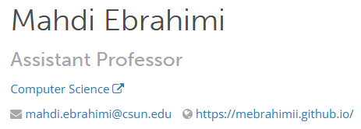


Slide 12
Software Requirements
FUNC_SRS_(1.0) – The program shall have 3 distinct sets of tools: Class Planner, Professor Viewer, Major Explorer
FUNC_SRS_(2.0) - The Class Planner shall allow the user to explore classes and create possible schedules for a given semester
FUNC_SRS_(2.1) - The Class Planner shall allow the user to pick classes and react as the user selects a class.
FUNC_SRS_(2.2) - The tool shall have dropdowns that allow the user to pick a subject and have it display all the sections available for that subject in a pre-chosen semester.
FUNC_SRS_(2.3) - If the user attempts to pick a class that conflicts with an already chosen class, it shall warn the user that the schedule would be invalid.
FUNC_SRS_(2.4) - Per class chosen, the tool shall show the user the tuition cost of their current selections and should update on every addition or removal of a class
FUNC_SRS_(3.0) - The professor viewer shall allow the user to look at professors within a chosen department.
FUNC_SRS_(3.1) - The product shall allow users to rate a professor for a given class in a given subject.
FUNC_SRS_(3.2) - The viewer shall display contact information as available of professors within a department. The viewer will provide information available about a Professor as such.
FUNC_SRS_(4.0) - The major explorer shall allow the user to look at the class requirements for each major provided by CSUN.

Slide 13
Software Testing
Used the Cypress testing framework for E2E testing
Split across 5 specs
home.spec.js
planner.spec.js
majors.spec.js
faculty.spec.js
ratings.spec.js
E2E tests run on every push using Github Actions
Unit Testing done in Python
Since the server was written in Python it was easier to test in with packaged testing suites that came with the Flask/FastAPI framework
Checks each GET endpoint, expects 200 status code
Checks valid and invalid test bodies for POSTS, expects 200 status code
POSTS returned a 405 status code when you attempt GET.

Slide 14
App Demo
Video
TRY IT!!!
Website: https://csundash.kyeou.xyz
API: https://api.kyeou.xyz

Slide 15
Future Developments
Backend
Maintain a higher degree of synchronicity between the class schedules
If a class gets canceled, there is no delete procedure in the crawler
Rate limiting
In its current state, it’s super easy to DDOS the entire application
The Professor Ratings can be spammed
API can be easily flooded with requests
Frontend
Allow users to create accounts to save schedules.
Would allow for a student to visualize more than one possible schedule
Would allow for a DPR-like viewing of progress

Slide 16
Regrets/Lessons
Don’t couple your deployment strategy with the frameworks you use
Made it hard to switch from Flask to FastAPI
Don’t allow the terrible solution to work better than the better solution
Flask Request Handling:
Each request in Flask ties up a the worker that handles requests, limiting concurrent processing capabilities.
Database Connectivity:
Our non-redundant database setup lacked connection pooling.
Consequently, only one connection to the database could be maintained at a time.
Result:
Comparison: 5000 synchronous requests (Flask) vs. 5000 asynchronous requests (FastAPI)
The synchronous approach outperformed the asynchronous method
FastAPI couldn’t even pass stress testing
With a single maintained connection, synchronous requests benefited from consistent and focused database access.

Slide 17

Q/A

